Slide 1
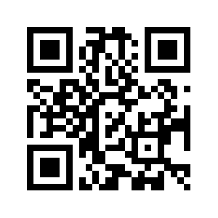
Controlling for the general psychopathology factor ‘p’
in genomic research on psychiatric disorders
Wangjingyi Liao¹, Engin Keser¹, Andrea G. Allegrini, Kaili Rimfeld, Robert Plomin² and Margherita Malanchini²
Preregistration
¹ These authors contributed equally
² These authors jointly supervised the work
Notes:
Hello everyone My name is wliao today I'm going to follow up with my colleague Engin's talk on our project controlling further general psychiatric factor P in genomic research on psychiatric disorders

Slide 2
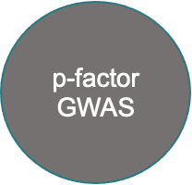
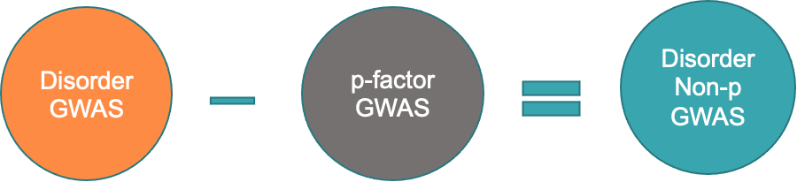
Genome Wide Association Analysis
Notes:
Just a little recap from Engin's talk we used genomic SEM to conduct a common factor gwas from the 11 major psychiatric disorders to extract the genetic effects of p. Then we use gwas by subtraction to remove the P factor from each of the disorder gwass to get the genetic effects that are not captured by p.

Slide 3
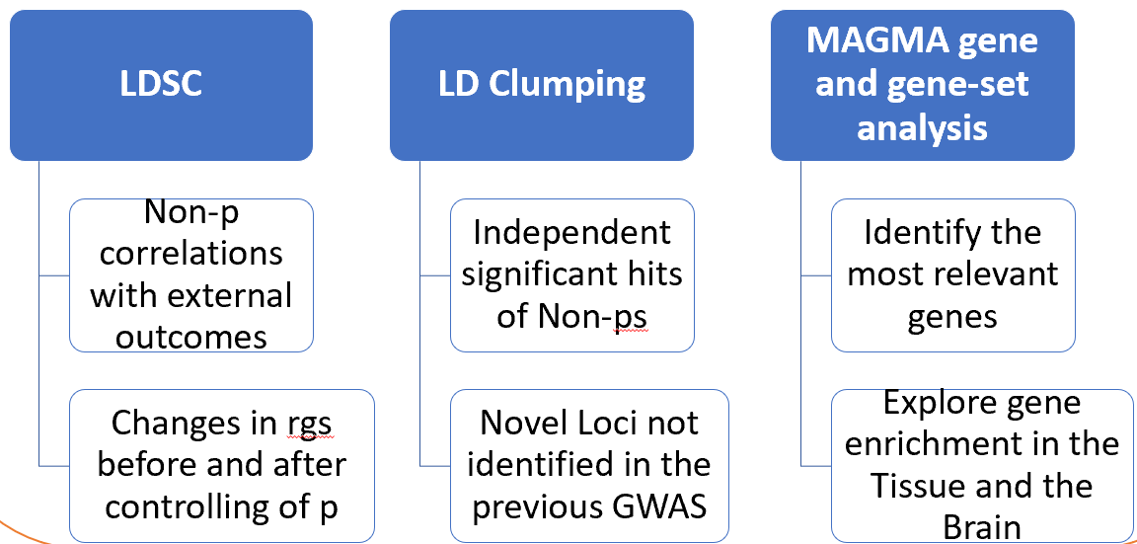
PART 2 - Downstream analyses of P and Non-P
Downstream Analyses
Aim: Comparing disorders before and after taking out p in downstream analyses
Genetic correlations with biobehavioural traits (Demographic, Anthropometric, Psychological and Health-related traits)
Novel loci identification
Gene, gene-set, tissue type and brain development stages enrichment
Method:
Part 2
Notes:
So! We got the summary statistics of the 11 Non-ps, what we are going to do with it? Off course, your first instinct will to explore them in the GWAS downstream analyses. Yes that’s what we did as well. So the aim of my talk is to applying the downstream analysis in our summary statistics and to compare the genetics of psychiatric disorders before and after we residualizing for P.
There are three sections in my downstream analysis: genetic correlation, LD clumping and MAGMA.
We firstly will show your how the psychiatric disorders correlated with external biological and behavioural traits before and after we taking out p.
Then we move to the linkage disequilibrium Clumping results where we identify the independent significant hits and risky loci of the 11 Major psychiatric disorders that are not captured by P.
And last but not least, we moved from the SNP level results a step forward to the gene level analysis using magma where we identifying the most relevant genes to the disorders that are independent of p, we will examine their gene enrichment as well.

Slide 4
Psychological
Socio-demographic
Anthropometric
Health related
Genetic Correlations with external traits using LDSC
Notes:
We used linkage disequilibrium score regression to examine the genetic correlation with external traits. we have four categories.
for the demographic category we investigated some social economic status related traits such household income and neighbourhood deprivation, as well as longevity
The next category is the anthropometric traits including BMI, birth weight and height.
For the health related traits, broadly we are investigating risky behaviour, fertility and health.
finally for the psychological category we investigated the correlation with cognition personality and well-being.

Slide 5
Average Genetic correlations between Psychiatric disorders and categories of external traits

Slide 6
Psychological Traits

Slide 7
Psychological Traits

Slide 8
Health Related Traits

Slide 9
Health Related Traits

Slide 10
Changes in rgs
Mostly reduction
Some reversed correlation
Few stronger correlation

Slide 11
Novel SNPs were found in 4 disorders
Disorder | Number of independent Hit | Novel SNPs | Most significant Novel Hits | Notes
Schizophrenia | 114 | 26 | rs7746199 | not in the Schizophrenia GWAS uncorrected for p, but was found in other GWAS of schizophrenia specificity (Wu, et al., 2020)
Bipolar | 19 | 9 | rs12234369 | associated with education attainment in Lee et al., 2018
ADHD | 11 | 4 | rs797419 | no association was found
AN | 6 | 5 | rs9877794 | no association was found
ALCH | 2 | 0
Novel SNPs – genetic variants not reported in the published disorder GWAS before controlling for p

Slide 12
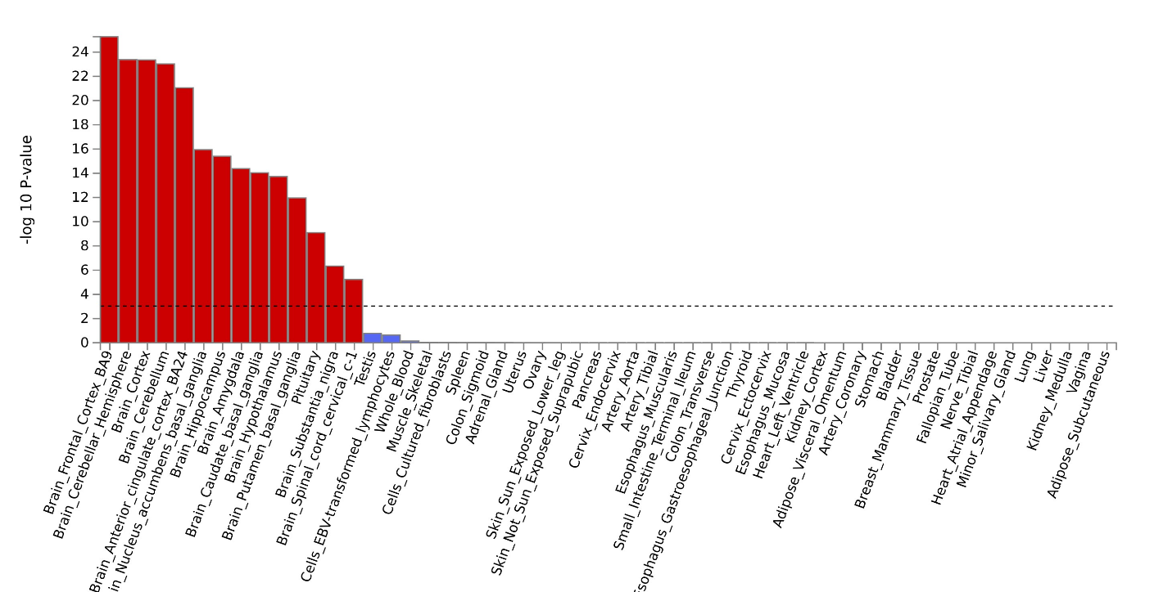
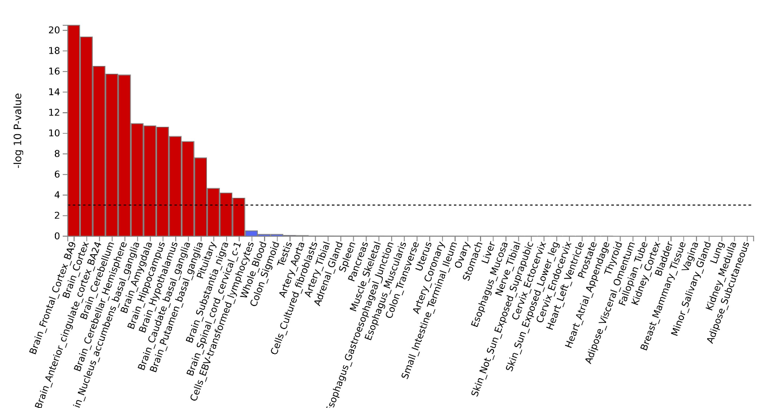
Less areas enriched in disorders after controlling of p
Supplementary Figure 15. Brainspan (Brain developmental stage sample) enrichment of SCZ uncorrected and corrected for p

Slide 13
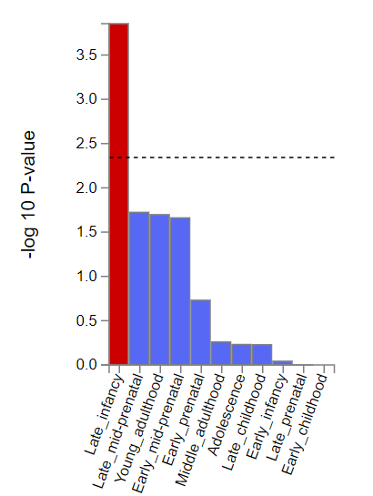
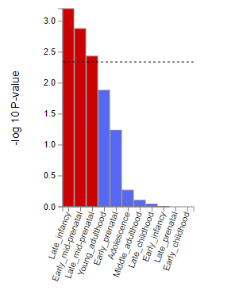
Changes in the Enrichment. Sharper profile?
before
after
Supplementary Figure 15. Brainspan (Brain developmental stage sample) enrichment of SCZ uncorrected and corrected for p

Slide 14
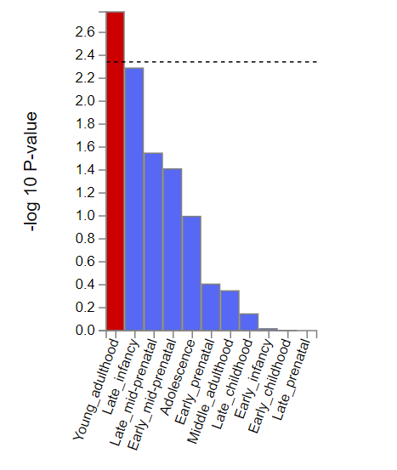
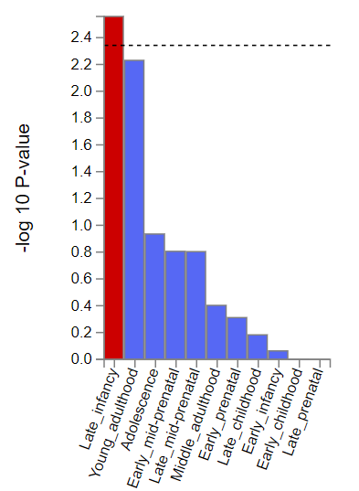
Changes in the Enrichment. Sharper profile?
before
after
Supplementary Figure 15. Brainspan (Brain developmental stage sample) enrichment of SCZ uncorrected and corrected for p

Slide 15
Discussion
Novel genetic variants were found
Some novel SNPs were reported in other studies: psychiatric GWAS studies or genomic studies, e.g. gene studies.
Are they genetic variants associated with SCZ, BIP, ADHD and AN specificities?
Changes in rgs with external traits
Removed the genetic correlations between traits contributed by p?
How to explain the few exceptions?
Changes in the enrichment
Different most enriched brain areas before and after controlling of p
Less enrichments in the different brain development stages, but stronger association. Sharper profile?

Slide 16
Gene and Gene-set Enrichment
Less Genes were associated with disorders after controlling for p
Less Gene-sets were associated with disorders after controlling for p

